Slide 1
LED Modules for Pentaphilia

Slide 2
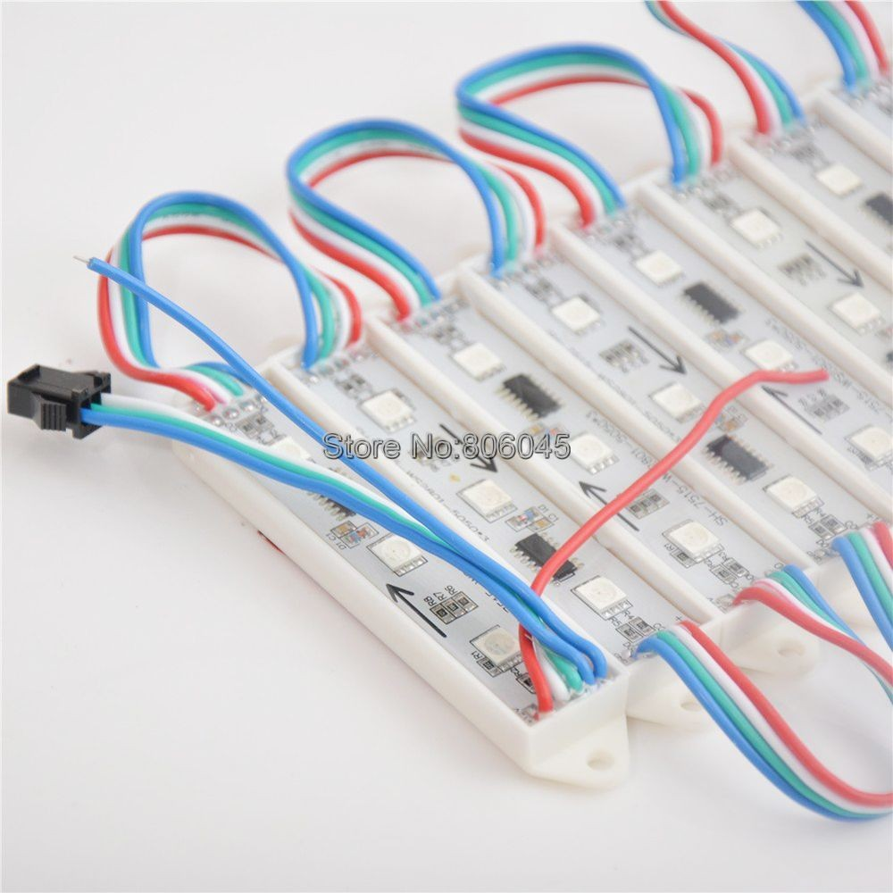
75mm by 15mm LED module
3x SMD505 RGB LEDs per module

Slide 3
Chipset | Supported | Wires | Color Bits | Data Rate | PWM Rate | Chipset Power Draw
APA102/DOTSTAR | √ | 4 | 8 | ~24Mbps | 20khz | 0.9ma@5v
WS2811 | √ | 3 | 8 | 800kbps | 400Hz | 5mw / 1ma@5v
WS2812B/NEOPIXEL | √ | 3 | 8 | 800kbps | 400Hz | 5mw / 1ma@5v
TM1809/TM1812 | √ | 3 | 8 | 800kbps | 400Hz | 7.2mw / 0.6ma@12v
TM1803 | √ | 3 | 8 | 400kbps | 400Hz | 7.2mw / 0.6ma@12v
TM1804 | √ | 3 | 8 | 800kbps | 400Hz | 7.2mw / 0.6ma@12v
WS2801 | √ | 4 | 8 | 1Mbps | 2.5kHz | 60mw / 5ma@12v
UCS1903 | √ | 3 | 8 | 400kbps | unknown | ?
UCS2903 | √ | 3 | 8 | 800kbps | unknown | ?
LPD8806 | √ | 4 | 7 | 1-20Mbps | 4kHz | ?
P9813 | √ | 4 | 8 | 1-15Mbps | 4.5kHz | ?
SM16716 | √ | 4 | 8 | ? | ? | ?
TM1829 | X | 3 | 8 | 1.6Mbps/800kbps | 7kHz | 6ma@12v
TLS3001 | X | ? | 12 | ? | ? | ?
TLC5940 | X | 4 | 12 | ? | ? | ?
TLC5947 | X | 4 | 12 | ? | ? | ?
LPD1886 | X | 3 | 12 | ? | ? | ?
Acceptable protocol table

Slide 4
5x modules with 180mm wire length.
TOTAL LENGTH of 5x modules = 1095mm
with JST connectors = 1455mm
JST connector (“clips”)
180mm wire length
180mm wire length.
180mm wire length.
180mm wire length.
180mm wire length.
JST connector (“clips”)
180mm wire length

Slide 5
(5 LED modules / edge) * (8 edge / P) * (2 P / DP) * (25 DP / build) = 1750 LED modules / build
Assuming 0.5 $/module = 875 $/build

Slide 6
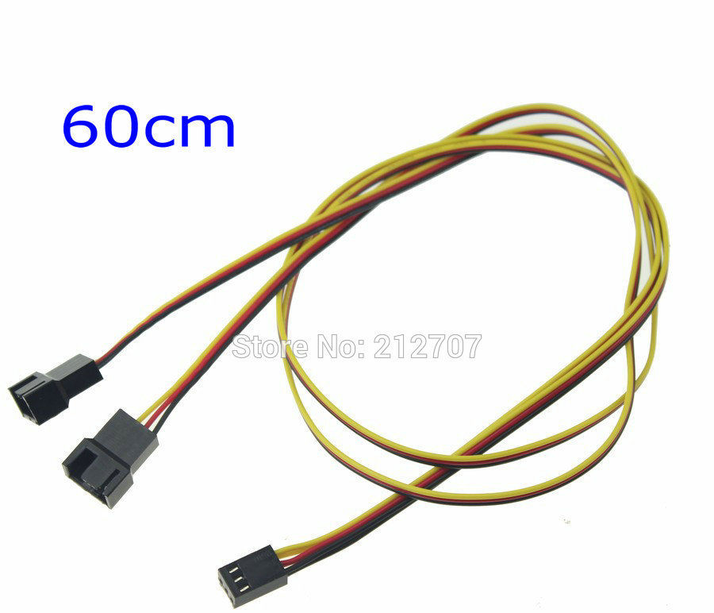
We’ll need 3-wire or 4-wire JST “Y Splitter” to bridge between P’s and to provide a 12VDC power drop and GND.
Can’t really specify these currently without knowing how the inter-DP wiring situation is going to work out.
Ideally, we’d specify and order these from the same supplier as the LED modules, so we know everything fits together.
JST connector (“clips”)
180mm wire length
JST connector (“clips”)
180mm wire length
Female
Male

